Slide 1

SNAPSCAPE.
ALL IN ONE WEB BASED PHOTOGRAPHY
SOLUTION & AI POWERED.
NAME : FEROZ MAHMUD
ID : 2030036

Slide 2
CONTENTS OF THIS TABLE
SnapScape is the leading Photography Based Website
Product Features | Portfolio Builder , Buy Courses , Book Events & Photo Contest Platform
Technical Features | Question Answer Based Forum & EXIF Photo Extractor
AI Features | Background Photo Remover , Photo Enhancing & AI Chatbot
Web Requirement | HTML , CSS , Bootstrap S5 , PHP , MySQL
Events & Course | Directly Purchase Your Courses & Book Events From Website (Save On Database)

Slide 3
Introduction
SnapScape is a one-stop platform for everything photography whether you are a photography , enthusiast, professional, or just want to learn it. The platform provides a modular, all-in-one experience for general-purpose photography needs, with solutions that include photography services, AI-driven editing tools like background removal and educational courses for
photographers

Slide 4
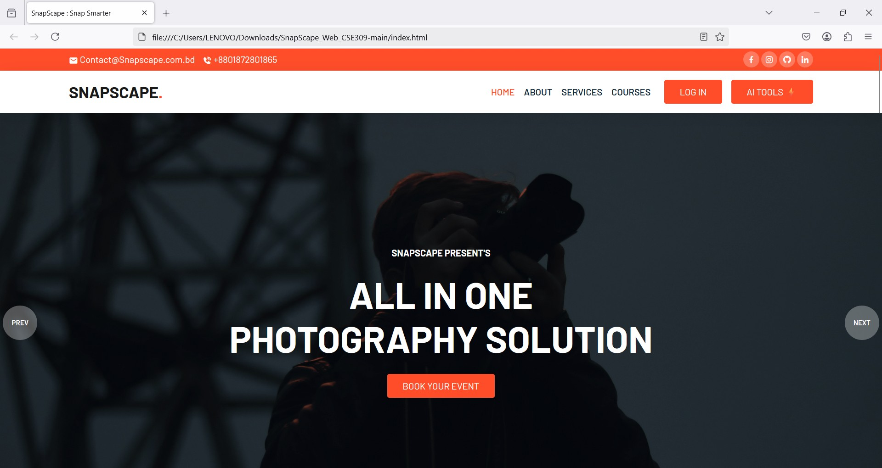
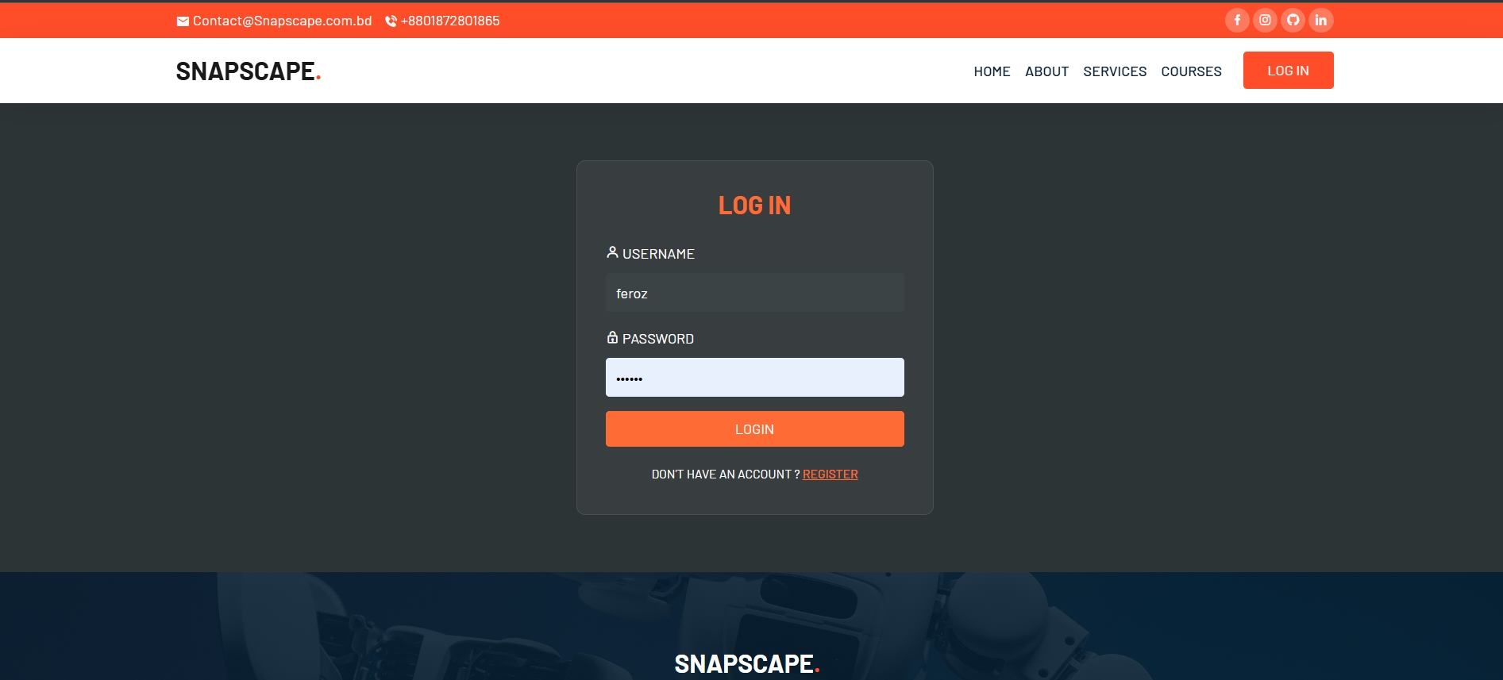
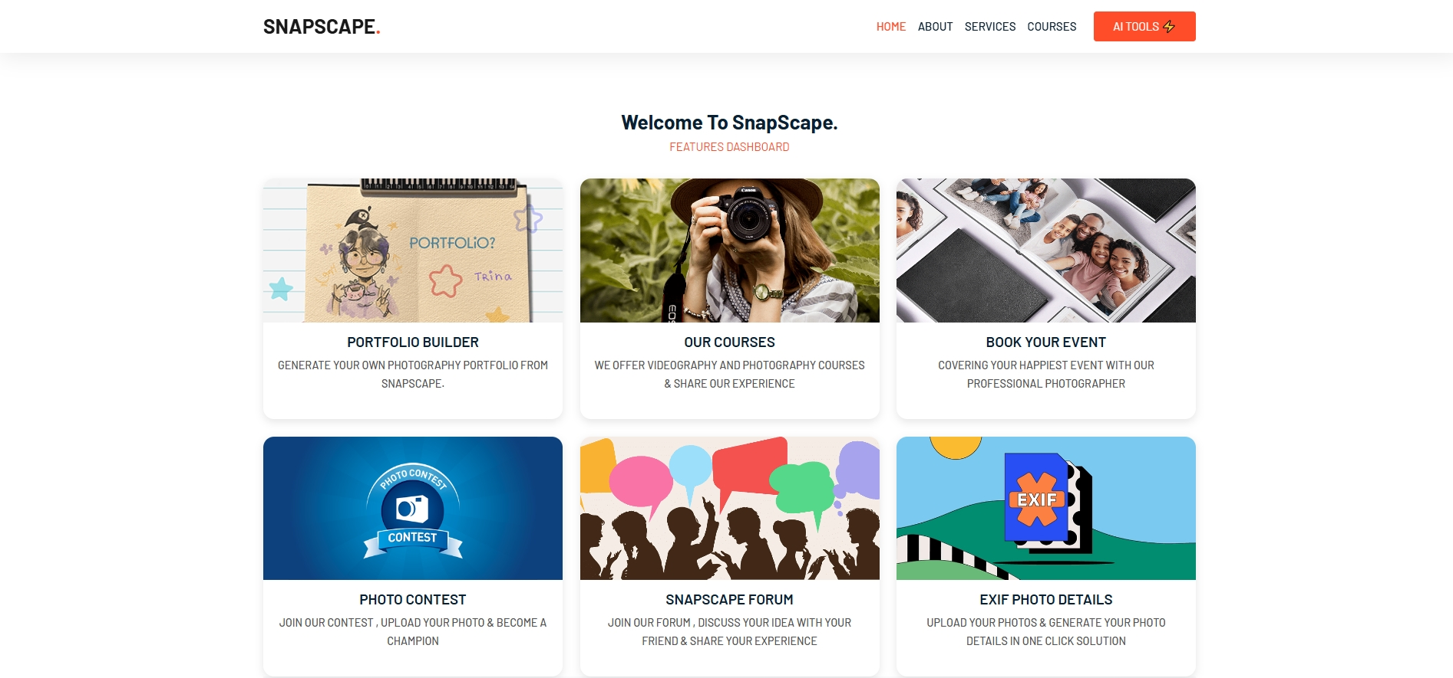
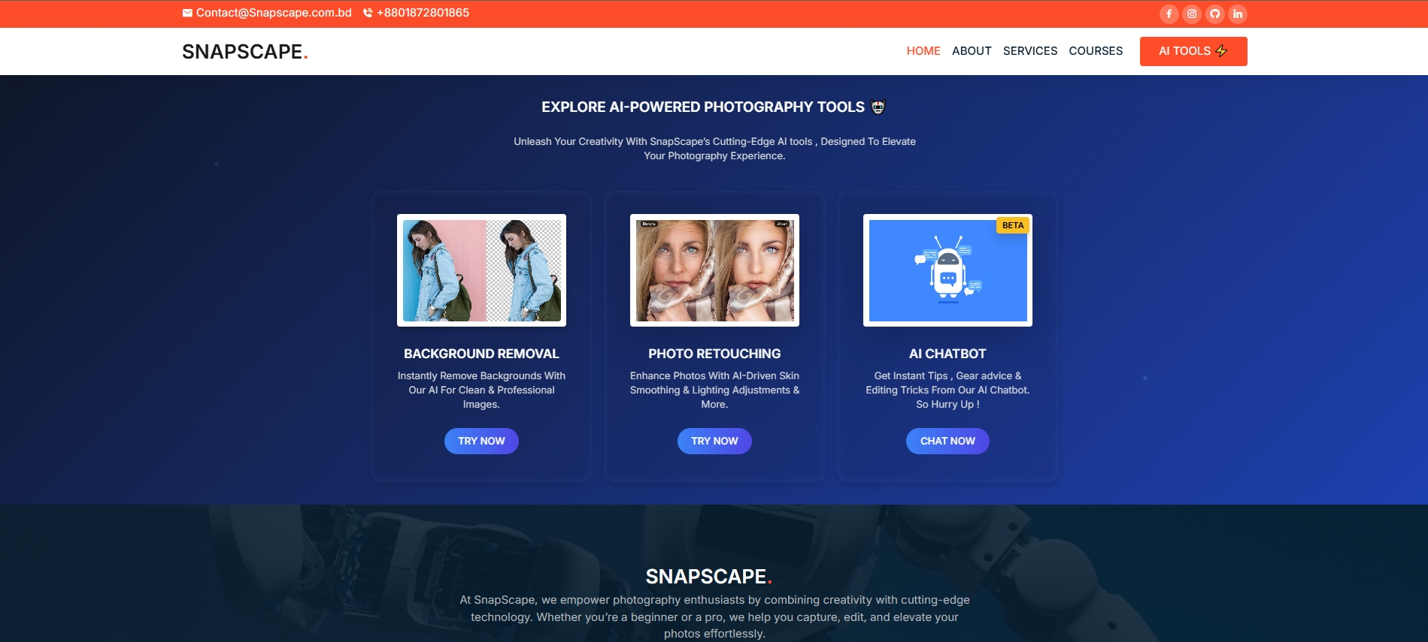
Project Design
LANDING PAGE
LOGIN PAGE
DASHBOARD
AI TOOLS

Slide 5


Front-End :
PROJECT BACKBONE
Back-End :

Slide 6
Features Of SnapScape.
Portfolio Builder
Buy Courses
Book Events
Build, customize & showcase your portfolio easily.
Purchase & start your course instantly today
Neptune is the farthest planet
Photo Contest
FORUM
EXIF Extractor
Join & Win in Photo Contest
Connect , Discuss & Share ideas in Forum
Extract , view & analyze photo EXIF data

Slide 7
AI FEATURES
AI
CHATBOT
BACKGROUND
REMOVE
PHOTO
ENHANCEMENT
Remove image backgrounds quickly & effortlessly online.
Enhance photo quality with powerful editing tools
Chat instantly with our smart AI chatbot

Slide 8

FEATURES OF

Slide 9
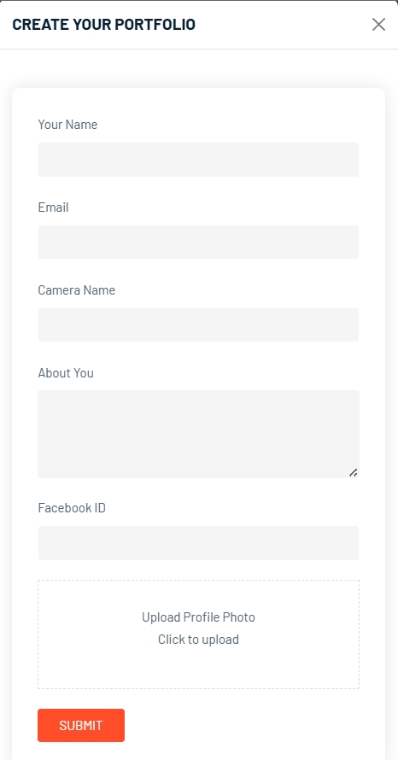
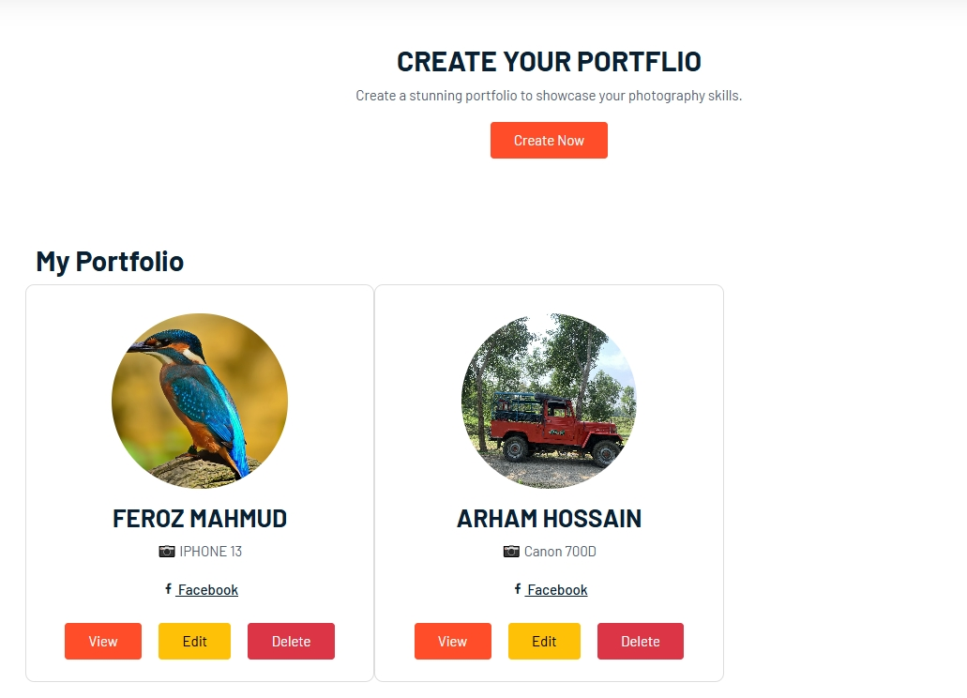
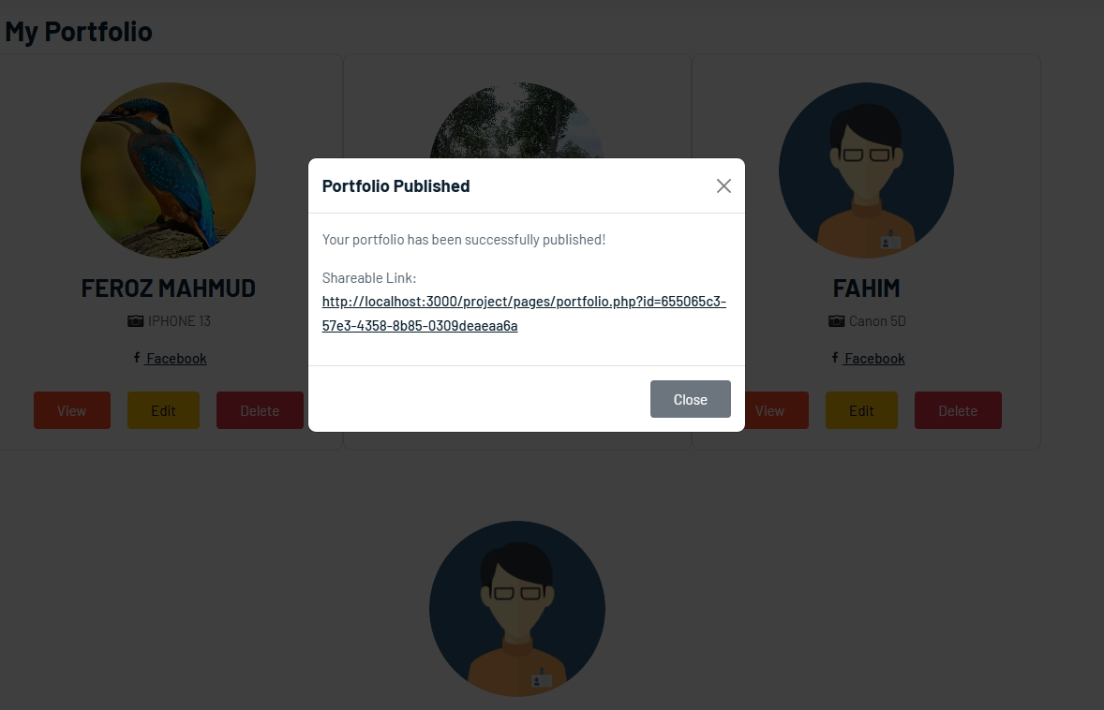
PORTFOLIO BUILDER
CREATE YOUR PORTFOLIO
SUBMIT YOUR FORM
ADD IMAGES
SHOW YOUR PORTFOLIO
ON OUR WEBSITE
GENERATE SHAREABLE LINK
OF YOUR PROFILE

Slide 10
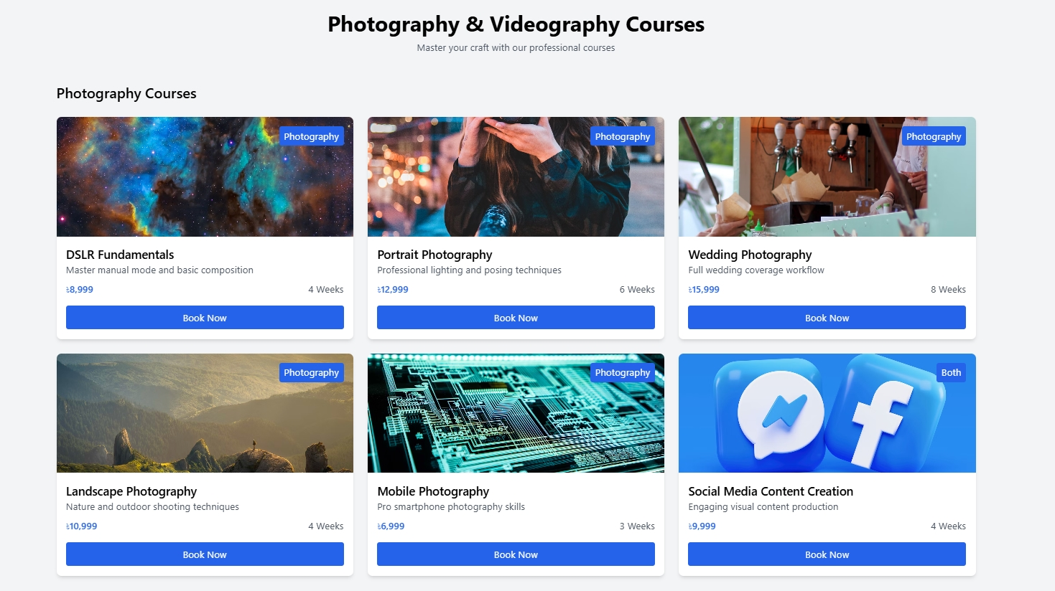
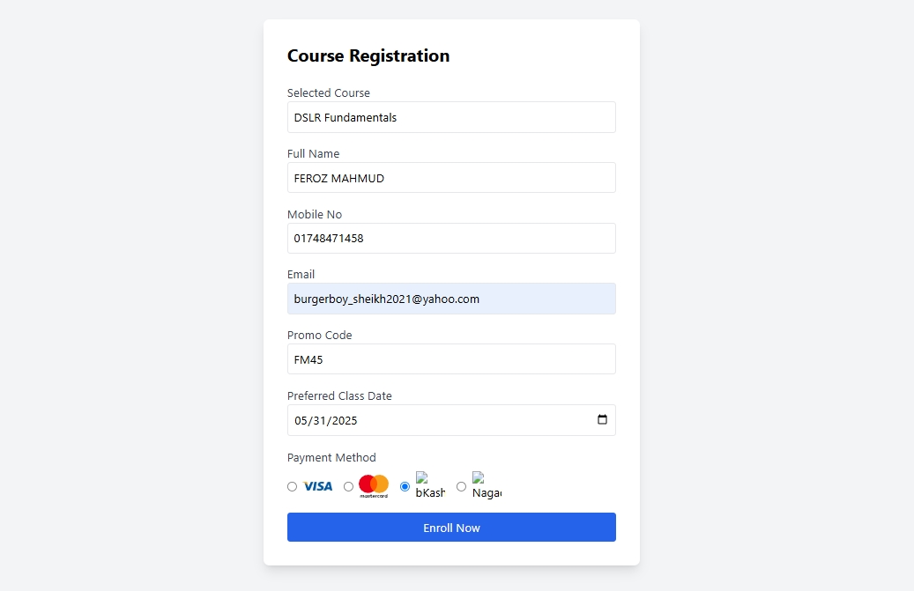
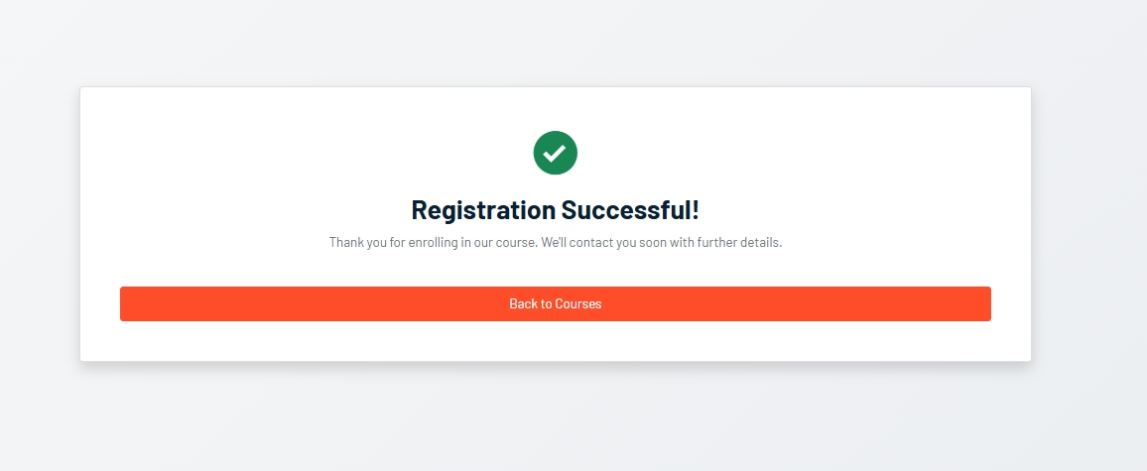
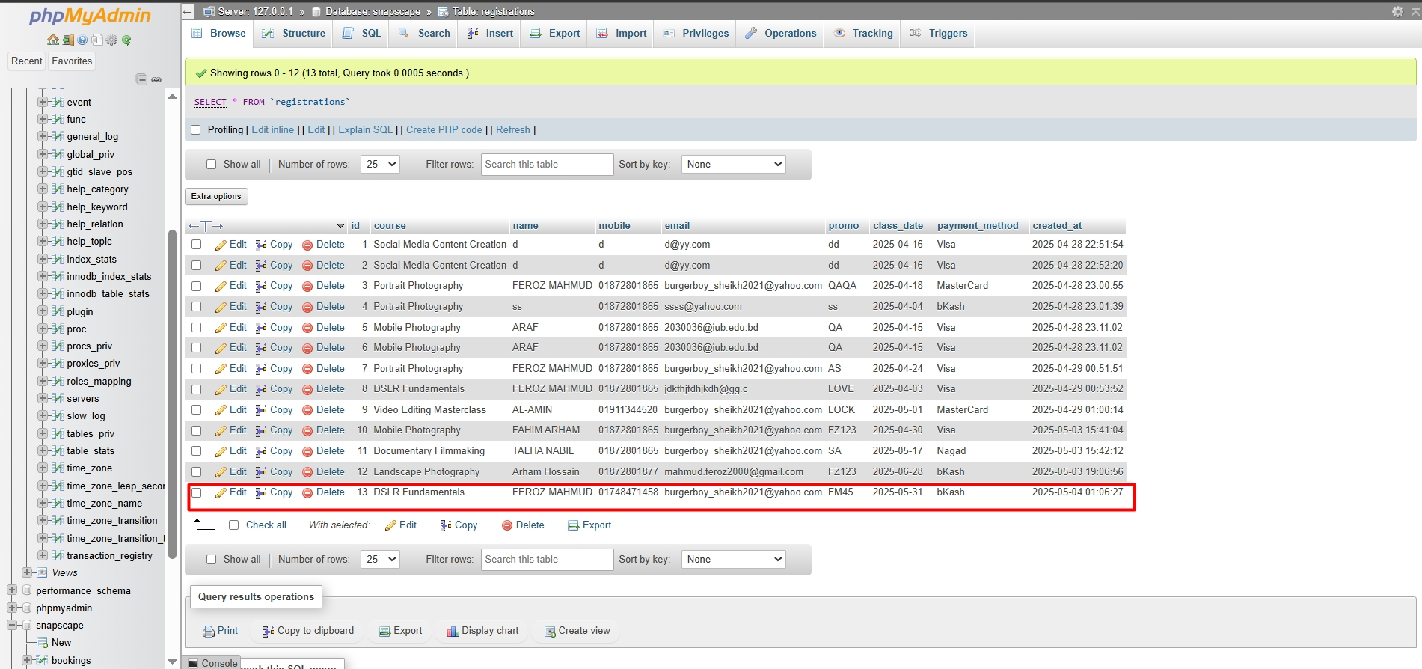
BUY COURSE
CHOOSE YOUR COURSE
SUBMIT FORM & PAY
REGISTRATION DONE
SAVED IN DATABASE

Slide 11
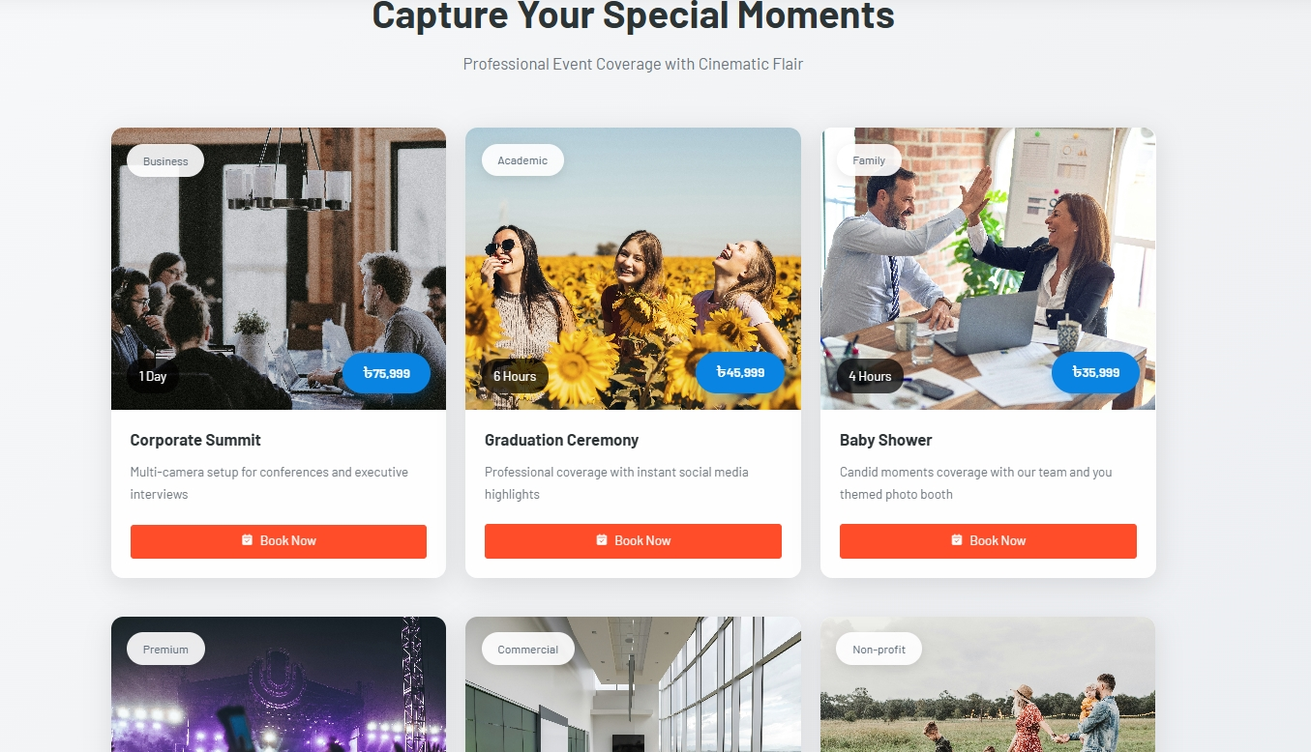
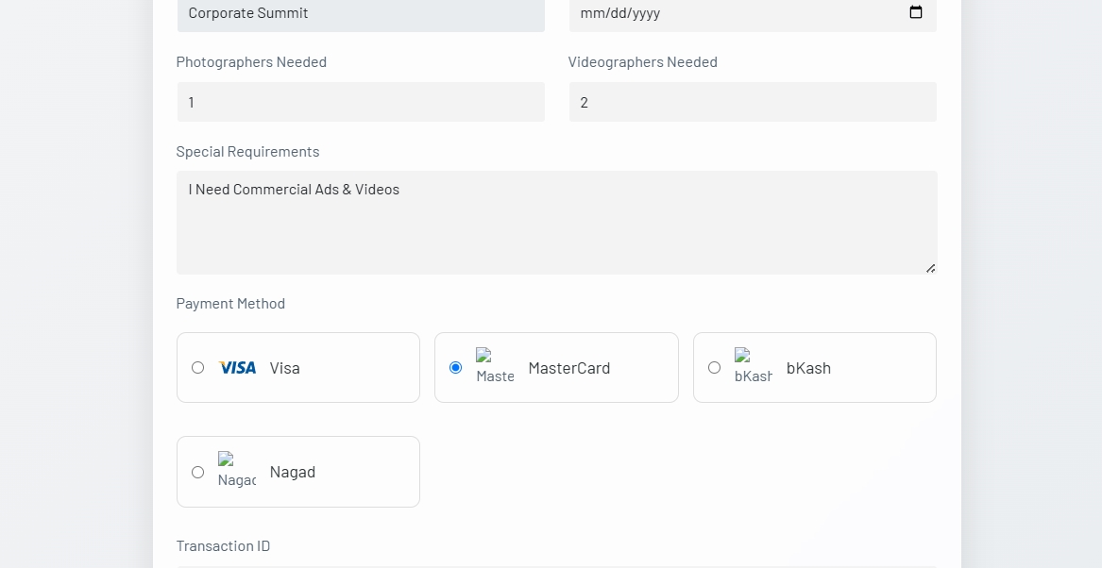
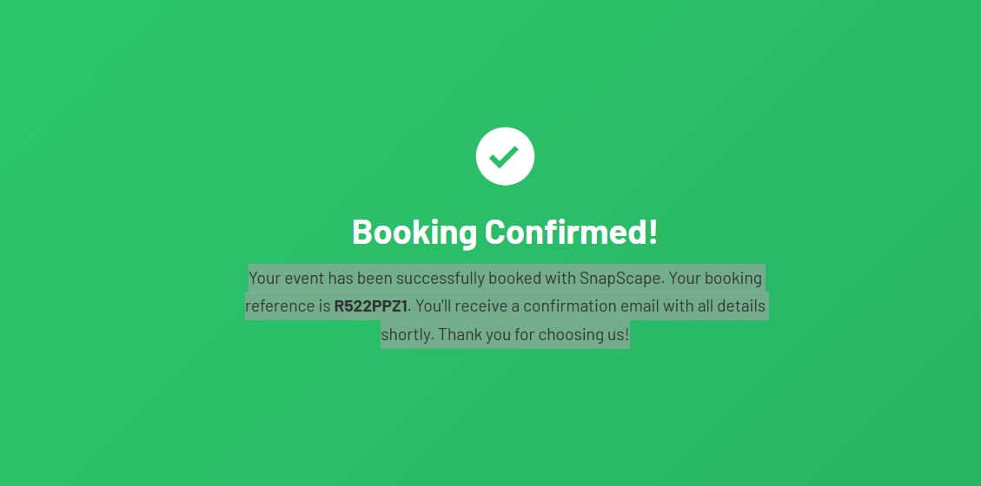
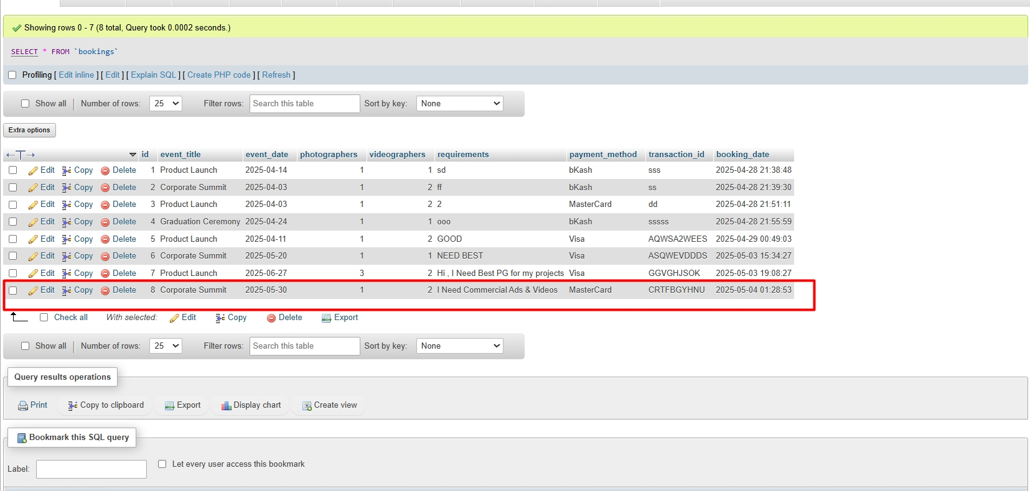
BOOK EVENTS
BOOK YOUR EVENTS
SUBMIT FORM & CONFIRM
BOOKING COMPLETE
SAVED IN DATABASE

Slide 12
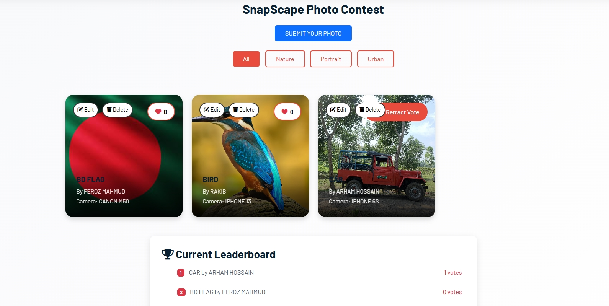
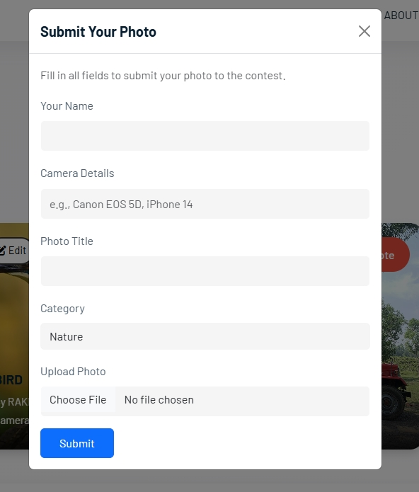
PHOTO CONTEST
SUBMIT YOUR PHOTOS
SHOW YOUR PHOTOS IN GALLERY
1 VOTE FOR 1 PERSON
LEADERBOARD FEATURE

Slide 13
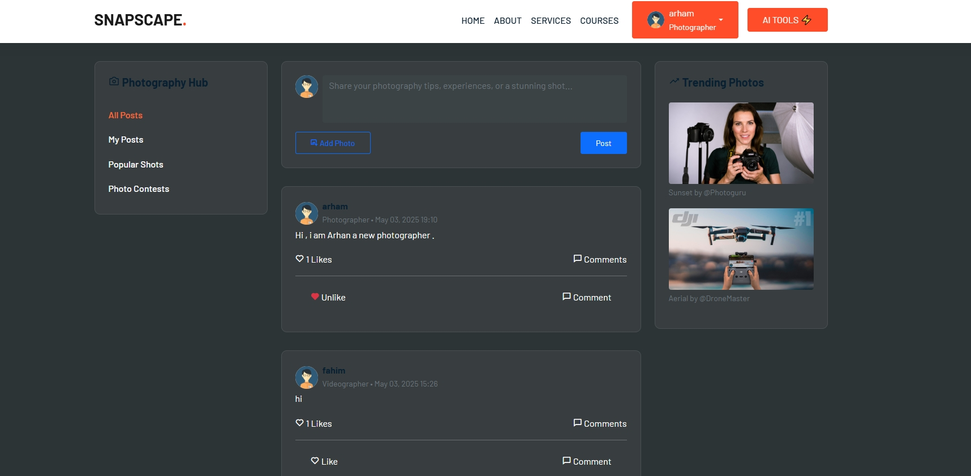
SNAPSCAPE FORUM
YOU CAN POST FROM YOUR PROFILE
LIKE & COMMENT ON POST
MODERN UI (DARK)
FORUM DATA SAVE ON DATABASE

Slide 14
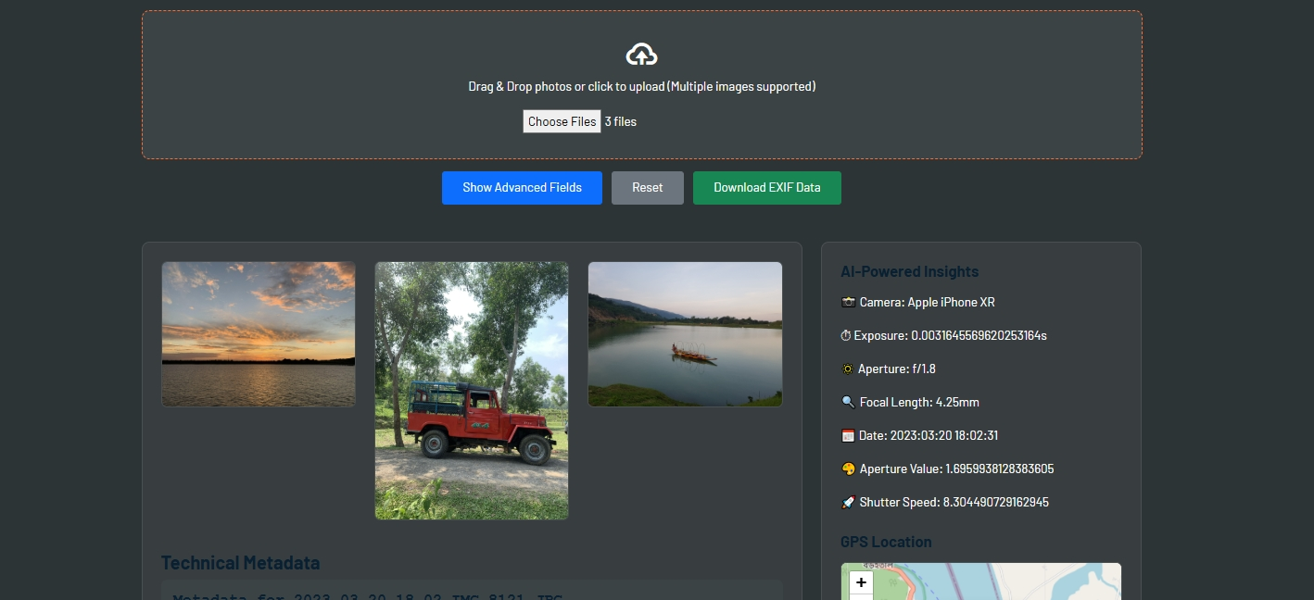
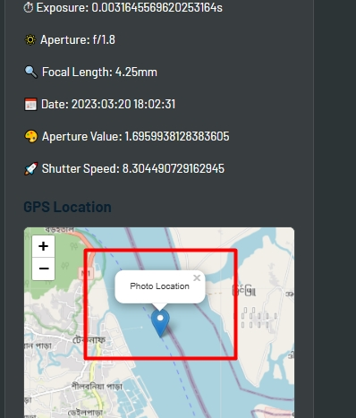
EXIF EXTRACTOR
ADD MULTIPLE PHOTOS
SHOW ADVANCE METADATA
PNG , JPG , WEBP (MAX 10MB)
GPS BASED LOCATION

Slide 15

FEATURES OF
Figure : System Diagram

Slide 16
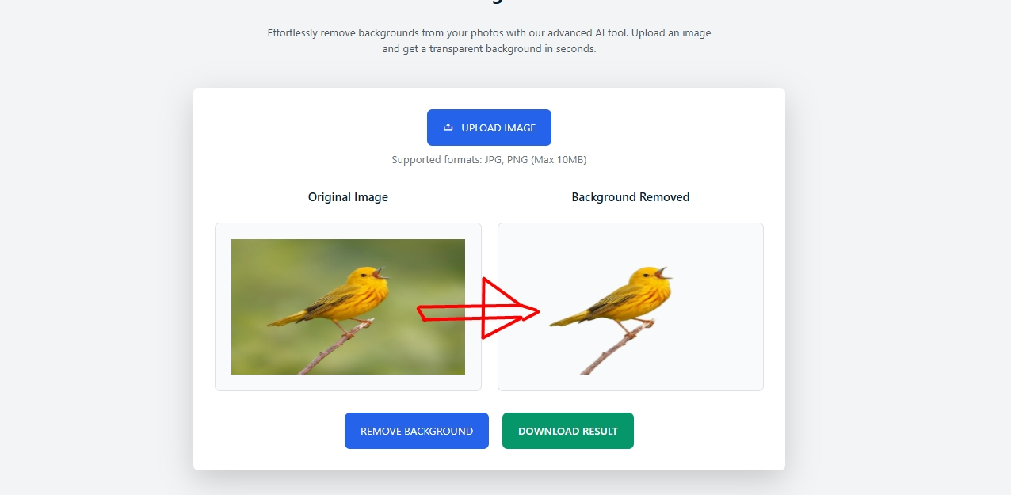

BACKGROUND REMOVER
UPLOAD YOUR PHOTO
CLICK REMOVE BACKGROUND
JUST WAIT & SEE
LOOK , YOUR BG HAS BEEN REMOVED

Slide 17
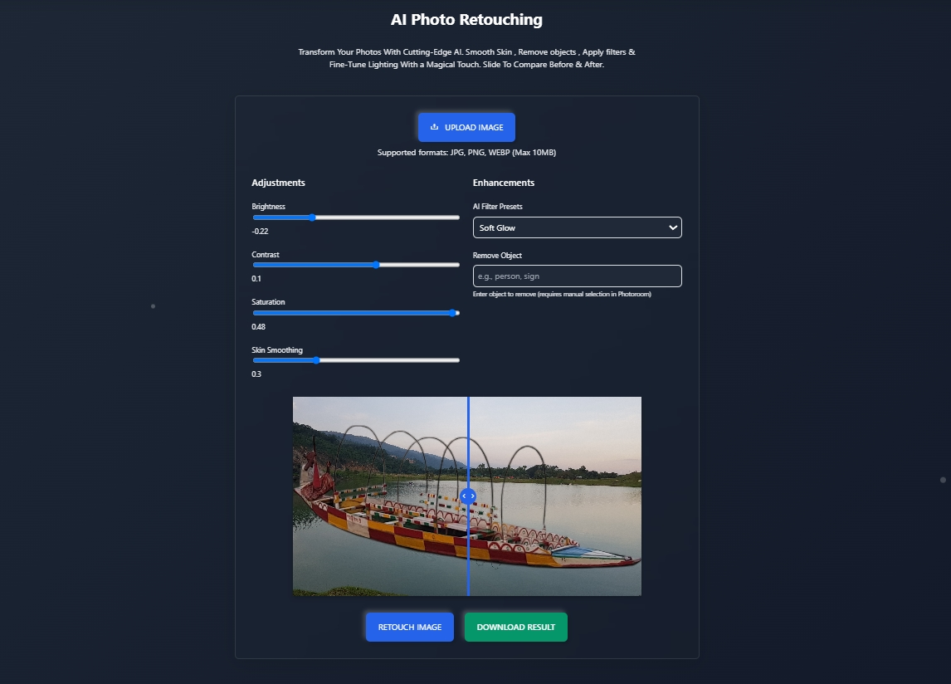
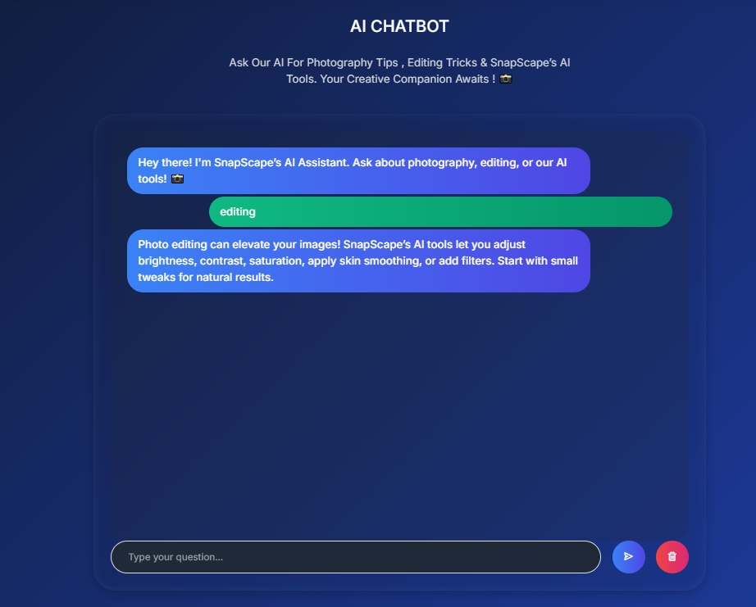
ENHANCING & AI CHATBOT
UPLOAD PHOTO
ADJUST YOUR SCALE
CLICK RETOUCH IMAGE & SEE
AI BASED CHATBOT
WRITE YOUR QUES & WAIT FOR YOUR ANS

Slide 18
Operating Environment
Browser Compatibility
Hardware Limitations
Optimized for major web browsers like Chrome, Firefox, Edge, and Safari to ensure a consistent user experience.
AI-driven editing capabilities, like background elimination, require sufficient processing power and memory.

Slide 19

Thanks
THE END

